Slide 1
AI-Powered LaTeX Diagram Generator for Academic Research
IBM HACKATHON PROJECT
Presented By: Aditya Sengupta
Student name : Aditya Sengupta
College Name & Department : Kazi Nazrul University & Metallurgical Engineering

Slide 2
OUTLINE
Problem Statement
Technology used
Wow factor
End users
Result
Conclusion
Git-hub Link
Future scope
IBM Certifications

Slide 3
Problem Statement
Researchers and academic writers often face significant challenges when creating diagrams in LaTeX, especially using the TikZ package. Writing TikZ code manually is time-consuming, requires technical expertise, and is prone to errors. This slows down the research documentation process and creates a steep learning curve for those unfamiliar with LaTeX graphics. There is a strong need for a user-friendly, intelligent tool that can simplify and automate this task.
Proposed Solution: I propose an AI-powered intelligent agent that automatically converts natural language descriptions and sketches into professional TikZ code for LaTeX documents. This agent will support real-time feedback, accept refinement commands in plain English, and produce publication-ready diagrams, eliminating the need for manual coding and significantly enhancing productivity for academic researchers.

Slide 4
Technology used
IBM cloud lite services
Natural Language Processing (NLP)
Retrieval Augmented Generation (RAG)
IBM Granite model

Slide 5
IBM cloud services used
IBM Cloud Watsonx AI Studio
IBM Cloud Watsonx AI runtime
IBM Cloud service
IBM Granite (via watsonx.ai studio)
IBM Cloud Object Storage IBM AI Tools

Slide 6
Wow factors
Natural Language to TikZ: Generate LaTeX diagrams from plain English.
Sketch Recognition: Turn rough hand-drawn sketches into structured TikZ code.
Real-Time Refinement: Update diagrams instantly with plain English commands.
Publication-Ready: Produces clean, high-quality diagrams for academic papers.
No Coding Needed: No prior LaTeX or TikZ experience required.
Deploy Anywhere: Web, desktop, or Overleaf-integrated support.

Slide 7
End users
Academic Researchers For thesis, paper, and journal diagram automation.
Professors & Educators For creating lecture notes, slides, and visual explanations.
Students (UG/PG/PhD) For simplifying LaTeX assignments and project reports.
Research Institutions & Universities For streamlining documentation and publication workflows.
Technical Writers & LaTeX Enthusiasts For enhancing productivity and accuracy in LaTeX graphics.

Slide 8
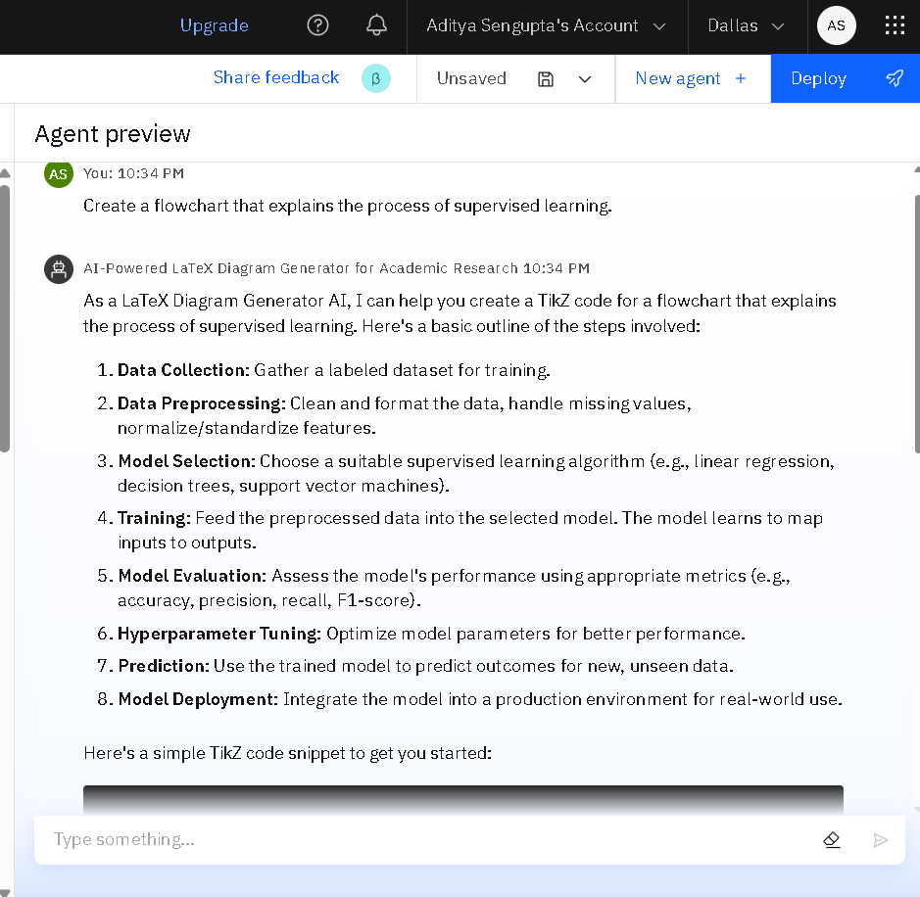
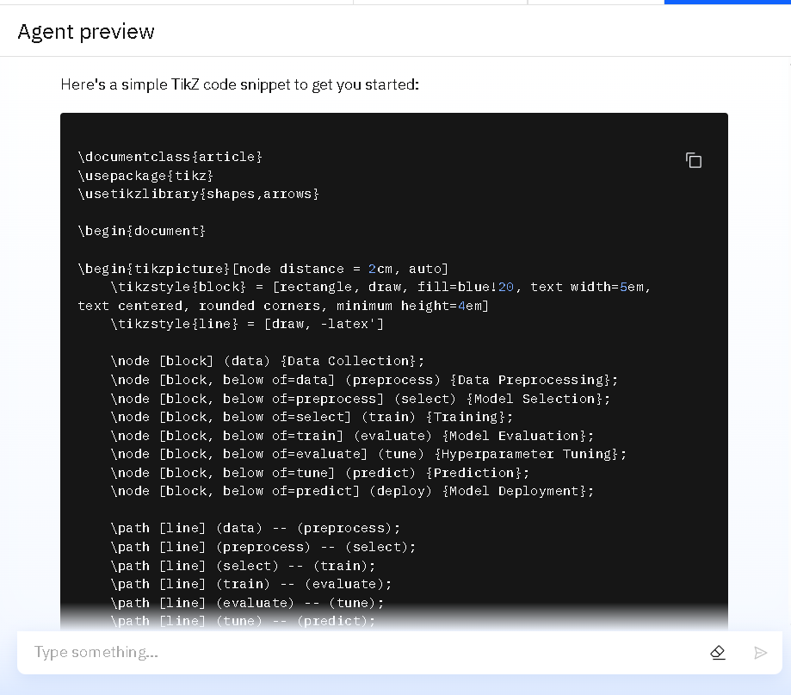
Results

Slide 9
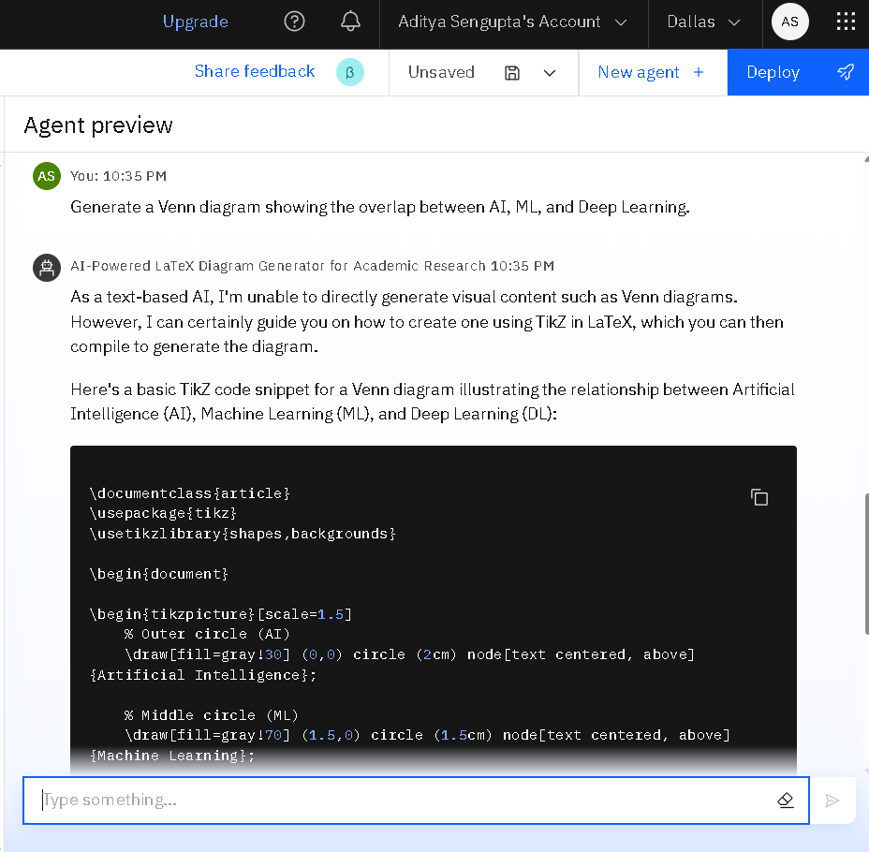
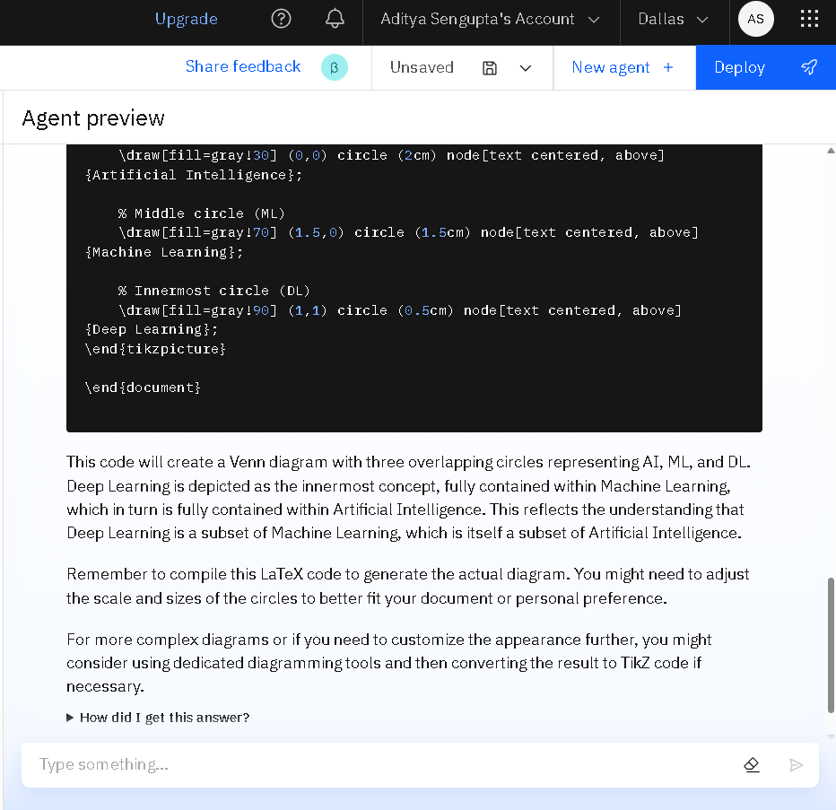
Results

Slide 10
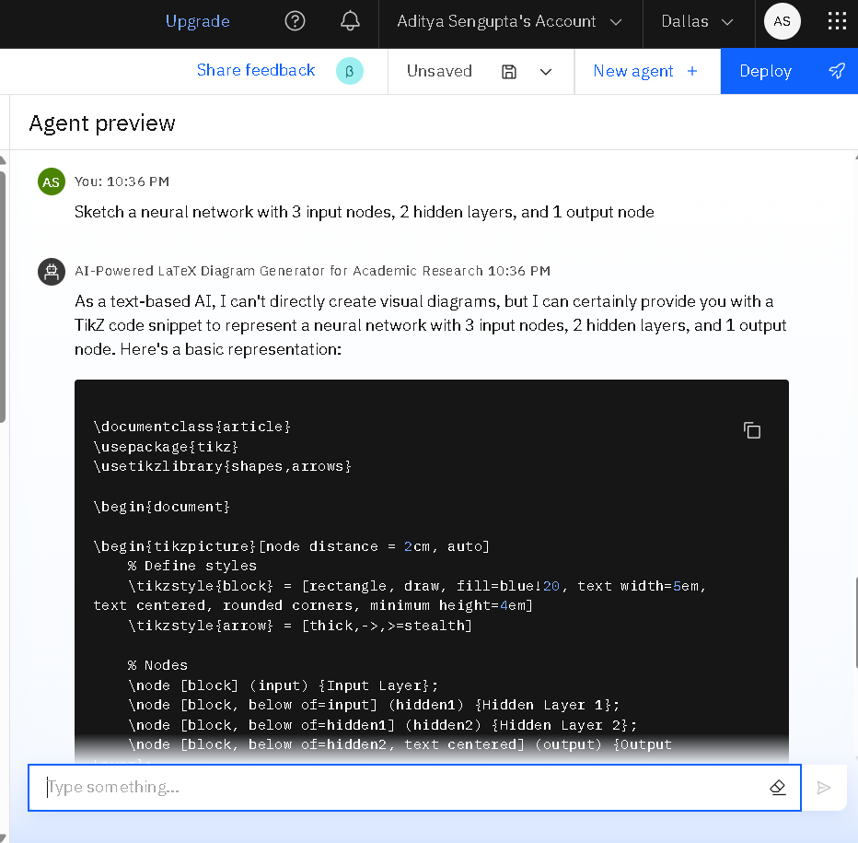
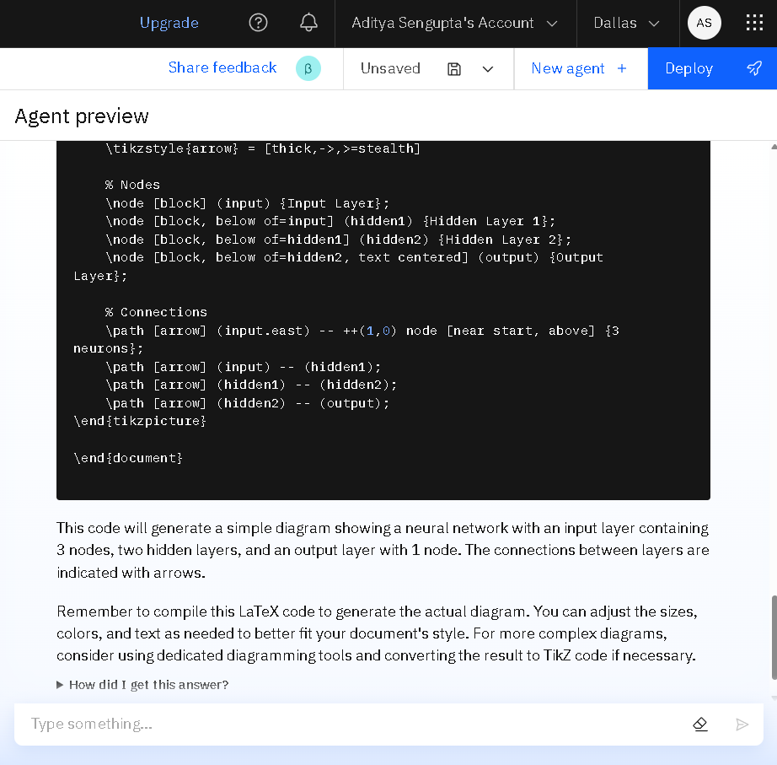
Results

Slide 11
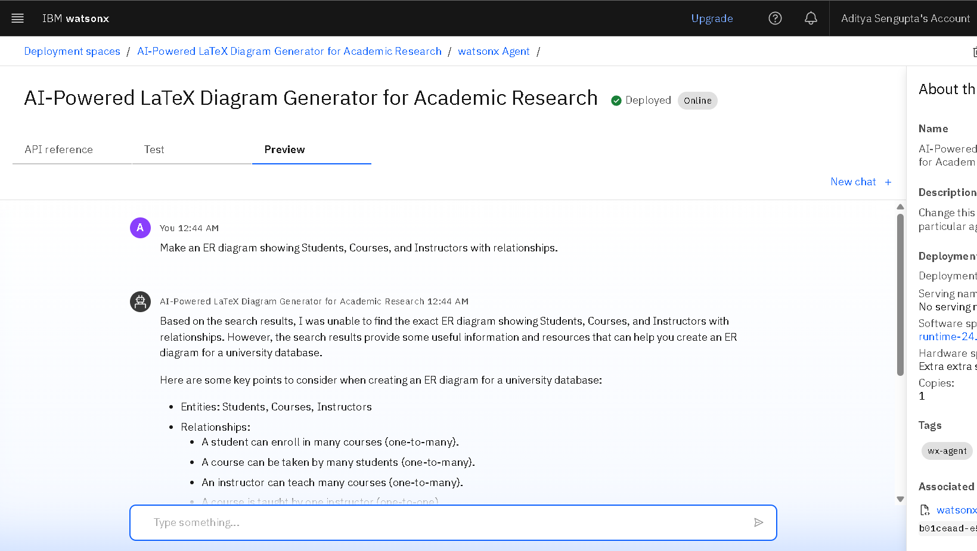
Results
Deployed AI Agent

Slide 12
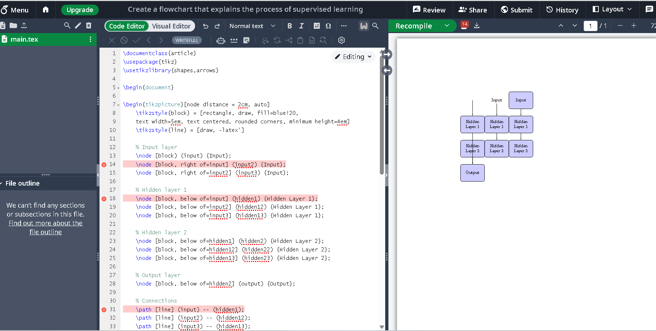
- Once the AI Agent generates the TikZ code, you can visualize the corresponding diagram by pasting the code into a LaTeX editor such as Overleaf, which renders the diagram from the TikZ instructions.
RESULTS

Slide 13
Conclusion
Simplifies Complex Tasks: Eliminates the need to manually write TikZ code by converting natural language or sketches into LaTeX diagrams.
Boosts Research Productivity: Saves time and effort for researchers, students, and educators by automating high-quality diagram generation.
Enhances Accessibility: Makes professional diagram creation accessible to non-technical users with real-time feedback and plain English commands.

Slide 14
GitHub Link
https://github.com/Adityasen-cmd/Edunet-Hackathon-Project-.git

Slide 15
Future scope
Voice-to-Diagram Generation Enable hands-free diagram creation using speech-to-text for accessibility and faster interaction.
Multilingual Support Accept input and commands in multiple languages to support global researchers.
Overleaf Integration Direct integration with Overleaf for real-time diagram preview and editing within LaTeX environments.
Auto-Diagram Suggestions Automatically suggest diagrams based on surrounding LaTeX text or content analysis.
Collaborative Editing Allow multiple users to co-edit and refine diagrams in real time for group research projects.
AI-Powered Diagram Optimization Intelligent suggestions for better layout, aesthetics, and labeling of diagrams.
Export to Multiple Formats Support PNG, SVG, and PDF exports alongside TikZ for broader use in presentations and publications.

Slide 16
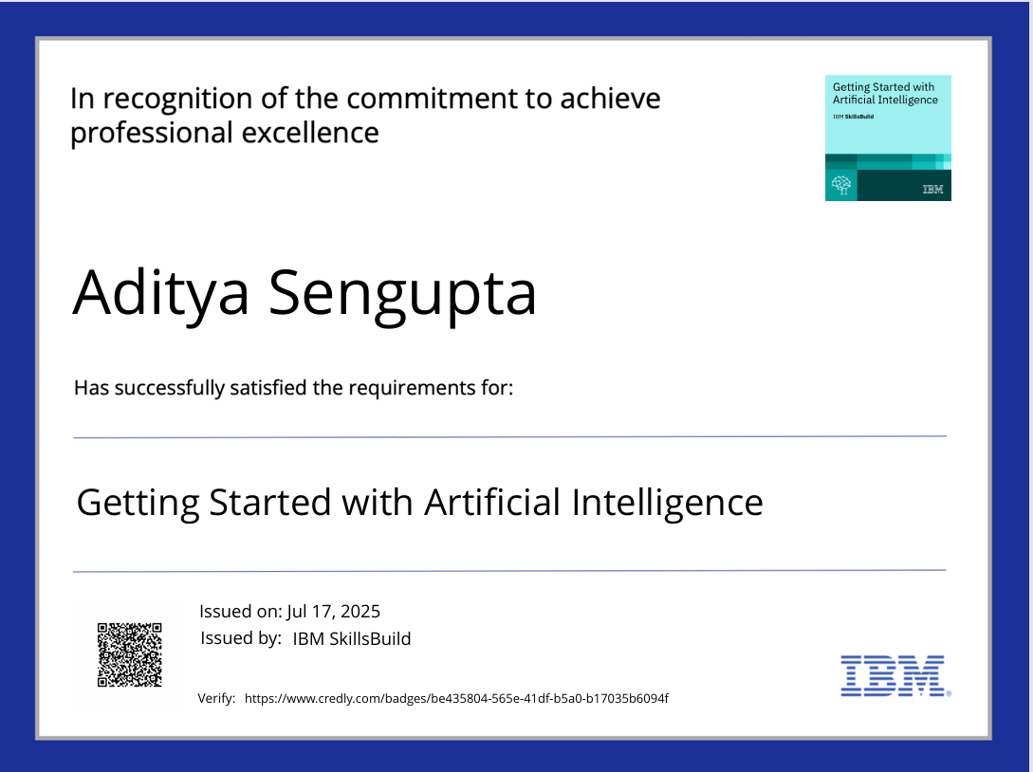
IBM Certifications
Certificate of Getting Started with AI

Slide 17
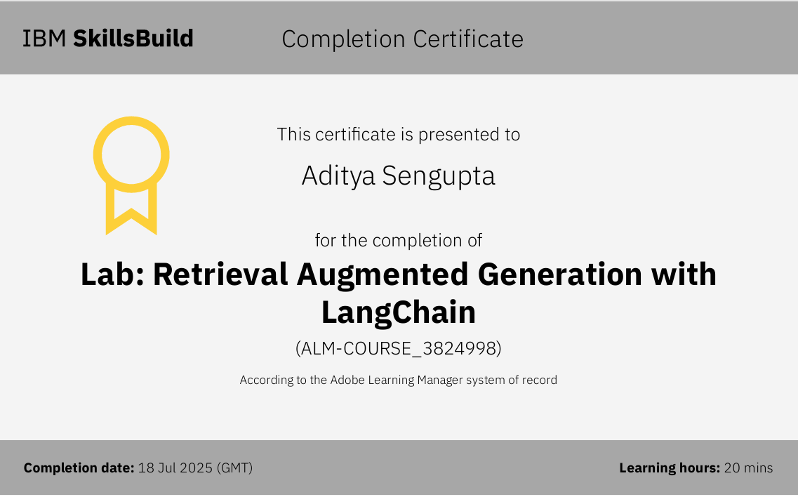
Certificate of RAG with LangChain

Slide 18
THANK YOU

